Slide 1
Loan Defaulters Prediction
$
LENDINGCLUB CORP.

Slide 2
Group Members
Ahmed Rashid
Joy Angel
Eric Ngugi

Slide 3
Table of contents
01
04
02
05
03
Business Understanding
Model Evaluation
Problem Statement
Recommendations
Insights & Visuals

Slide 4
01
Business Understanding
$
$

Slide 5
Business Understanding
LendingClub company specializes in making various types of loans to urban customers. When the company receives a loan application, the company has to make a decision for loan approval based in the applicant’s profile.

Slide 6
02
Problem Statement
$
$
$
A brief description including project objectives

Slide 7
Problem Statement
LendingClub company needs a better way to decide which loan applications to approve. Approving risky applicants leads to financial loss, while rejecting reliable applicants means missed profits to the company. By analysis of past loan data, we aim to predict default risk and support smarter lending decisions.

Slide 8
Project Objectives
To identify risky loan applicants in order to improve decision making.
To build a predictive model for loan default.
To evaluate model performances and model recommendations.
To design a deployment plan for integrating the predictive model into the company.

Slide 9
03
Insights & Visuals
$
$

Slide 10
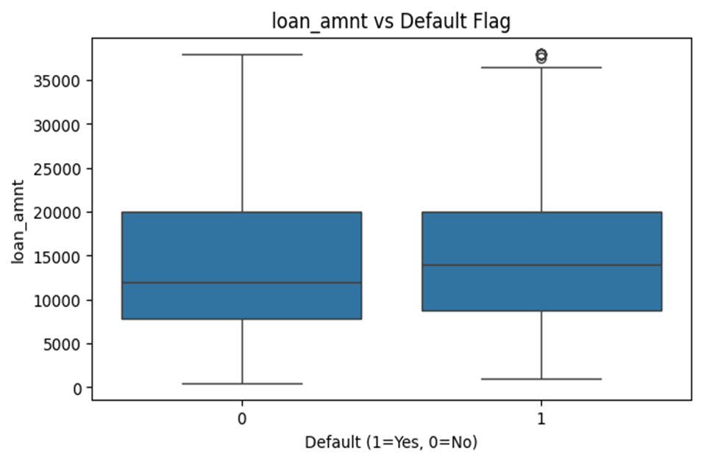
Loan Amount and Default Flag
Here we can see that the greater the loan amount the greater the probability of defaulting.

Slide 11
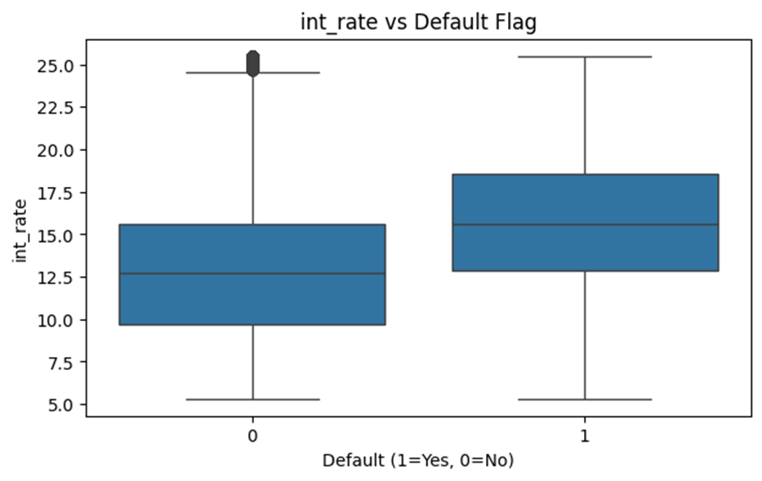
Interest Rate and Default Flag
Here we can see that the greater the interest rate the greater the probability of defaulting occurring.

Slide 12
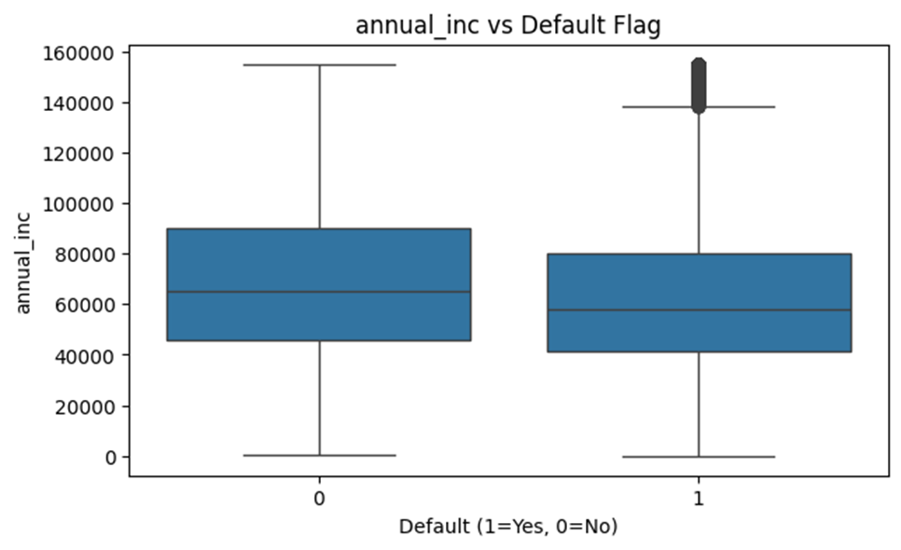
Annual Income and Default Flag
Here we can see that the less the annual income, the greater the probability of defaulting.

Slide 13
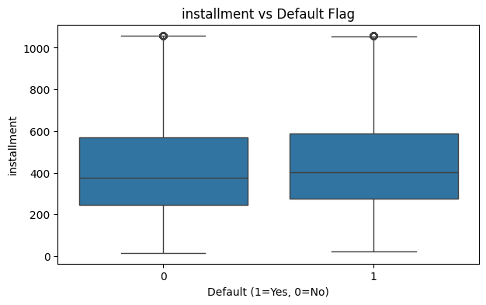
Installments vs Default Flag
Here we see that the amount of installments does not change the probability of defaulting.

Slide 14
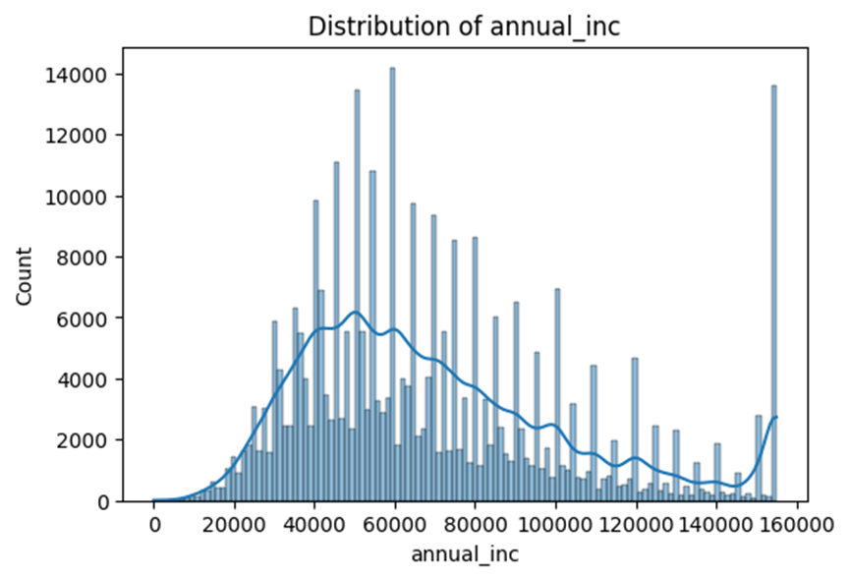
Distribution of Annual Income
This time we look at Defaulting factors in relation to Count.
We can observe that the Count is highest at a certain medium between 40,000 to 80,000 Dollars of Annual Income.
We conclude that the most people to take out loans are people of medium annual income.

Slide 15
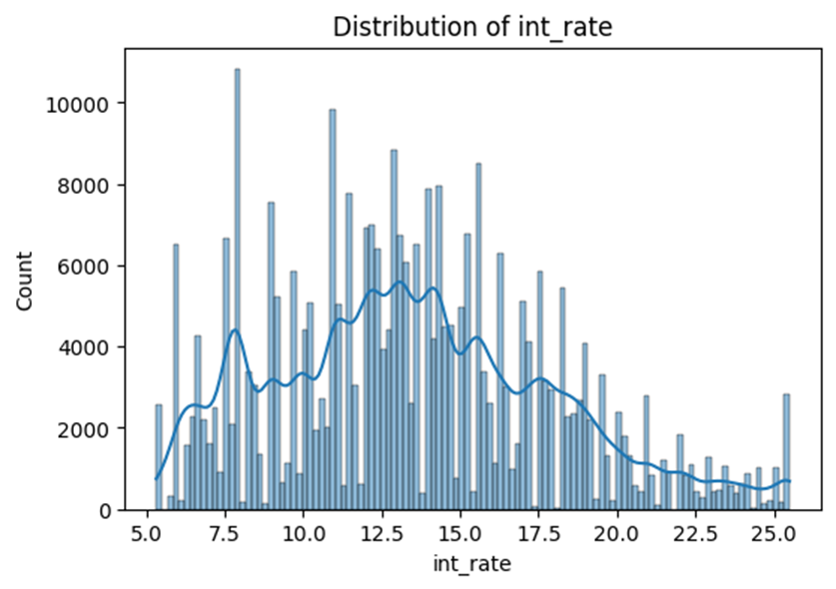
Distribution of Interest rates
This time we can see that the count is lowest at the two extremes of interest rate meaning most people accept neither high not low interest rates.

Slide 16
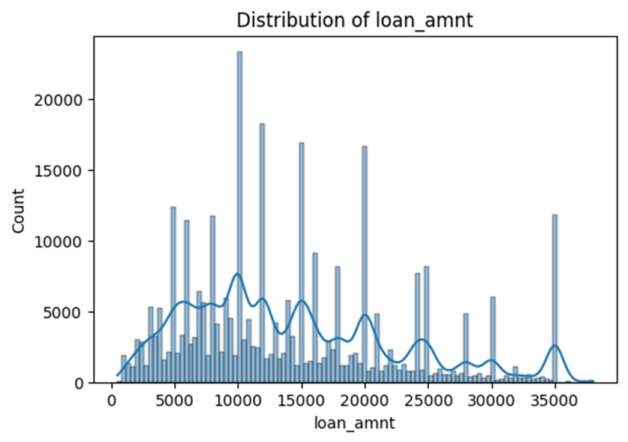
Distribution of Loan amount
We can observe that most people in this dataset do not take out high loan amounts seeing that most people take a maximum of 100,000 dollars. However, we can still see some outliers that take out a maximum of 300,000.

Slide 17
04
Model Evaluation
$
$
$

Slide 18
Model Performance Table
MODEL | DESCRIPTION | ACCURACY
Logistic Regression | Binary Classification | 80.83%
XGBoost | Performance | 80.80%
Random Forest | Classification | 80.82%
BEST MODEL: Logistic Regression

Slide 19
Performance Metrics Table
MODEL | CLASS | PRECISION | RECALL | F1 SCORE | ACCURACY
Logistic Regression | 0 | 0.81 | 0.99 | 0.89 | 80.83%
 | 1 | 0.54 | 0.06 | 0.11
XGBoost | 0 | 0.82 | 0.98 | 0.89 | 80.80%
 | 1 | 0.52 | 0.10 | 0.16
Random Forest | 0 | 0.81 | 0.99 | 0.89 | 80.82%
 | 1 | 0.54 | 0.06 | 0.11

Slide 20
Deployment
The models were deployed on Streamlit. The user inputs the loan applicant’s details then the model predicts the probability of the loan applicant whether they are likely to default.
A live version of the app is available here

Slide 21
05
Recommendation
$
$
$

Slide 22
Recommendations
The company should ensure that the model is maintained and retrained for better results to the company.
The company should improve methods of data collection so as to ensure completeness of the data which may be beneficial when improving model performance.
The company ought to benefit from the business model so as to improve their strategy.

Slide 23
THANK YOU!
$

